Slide 1
Amplitude Modulation and Demodulation

Slide 2
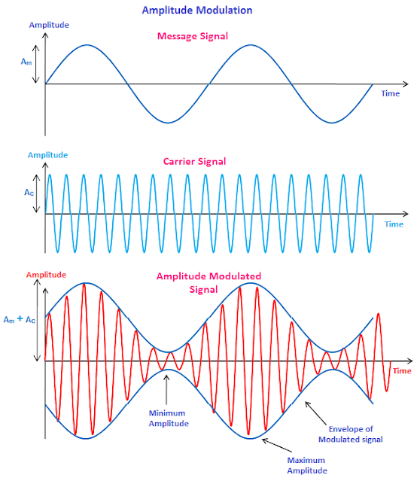
WHAT IS MODULATION
Modulation is the process of converting data into waves by adding information to a carrier signal.
Modulation is used to convert data into electronical or digital signals for transferring over a medium.

Slide 3
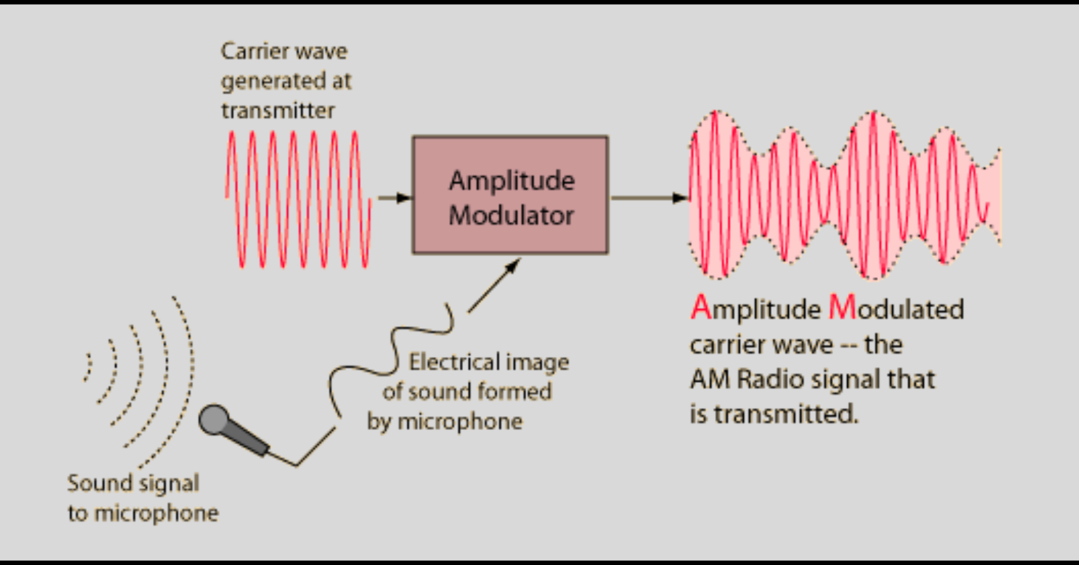
WHY MODULATION
At low frequencies sound waves tend to travel in all direction. As frequency increases the directivity of sound increases. So high frequency sounds is more likely to travel in a straight line.
Voice signal: up to 3kHz.
Audible spectrum: 20Hz to 20kHz.
These low frequency or the message signal is known as the baseband signal. That means it is essentially raw signal that hasn’t been shifted in frequency for transmission.
Baseband signal can’t be transmitted directly.But with the help of the high-frequency periodic signals, it can be transmitted.
This high-frequency periodic signal, which carries the baseband signal is known as the carrier signal.

Slide 4
HOW TO IMPOSE THIS MESSAGE/BASEBAND SIGNAL ONTO THE CARRIER SIGNAL?
Any signal has three basic properties: Amplitude, frequency and phase.
Modulation is the process, where one of these properties of the carrier signal is changed according to the baseband signal. And based on which property is changed there are different types of modulation.
WHY MODULATION IS REQUIRED
1)REDUCE THE ANTENNA SIZE
size of the antenna is proportional to wave length. L = λ/4.
c = λ * frequency.
(c-speed of light-3*10^8,
frequency-frequency of the transmitted signal,
λ-wavelength of the transmitted signal)
* f = 10kHz => λ = c/f = 30000m, L = λ/4 = 7500m antenna.
* f = 10MHz => L = 7.5m antenna.

Slide 5
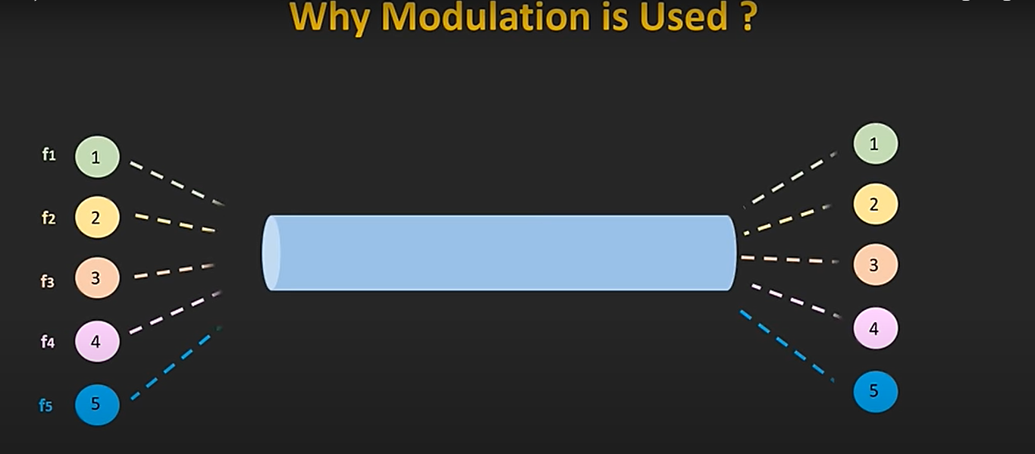
2)REDUCE THE INTERFERENCE
5 different voice signals which are around in the same frequency range are transmitted without the modulation through a single channel, then there will be interference between them and at the receiver we won't get the transmitted signal.
But instead of that, if each signal is modulated at the different carrier frequency, and all carrier frequency are relatively far away from each other, then there won't be any interference. And all the signals can be demodulated at the receiver and the message signal of each transmitter can be retrieved.
3)ALLOW MULTIPLEXING OF THE SIGNALS
Different message signals are modulated at the different carrier frequencies. Because of that, they can be transmitted simultaneously.

Slide 6
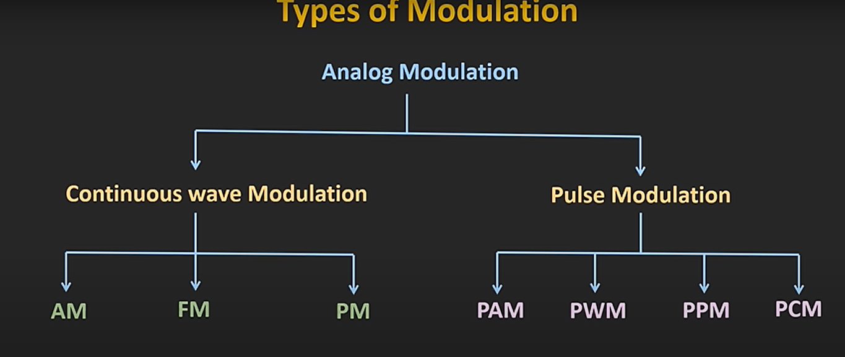
Types of modulation: Anolog and Digital modulation.
Analog involves continious signals. Digital involves discrete signal.
In amplitude modulation, amplitude of the carrier signal varies with respect to amplitude of message signal.

Slide 7
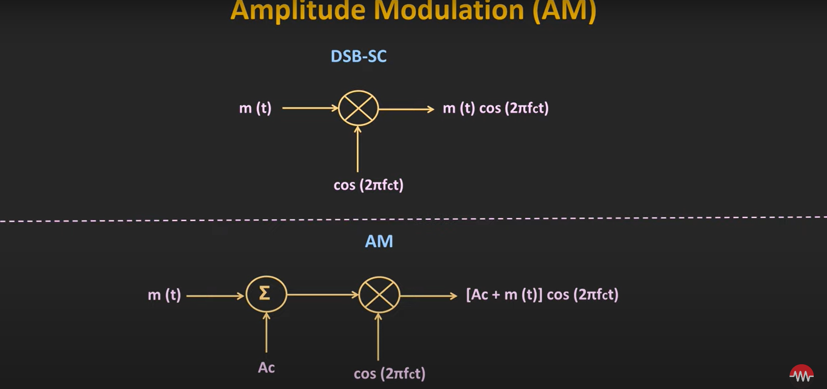
Baseband signal
Modulated signal
offset
Carrier signal
In amplitude moodulation some offset is added to the message signal, and then it is multiplied with the carrier signal.

Slide 8
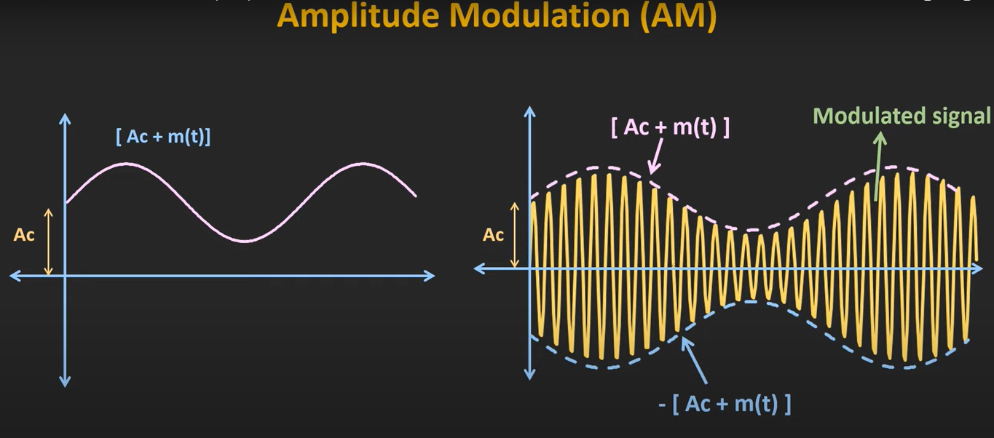
Baseband signal + offset
When we add some offset to this message signal, then it'll get shifted upwards by some amount. But this offset should be added in a such a way that there is no zero crossing of the message signal.
Ac + m(t) >= 0.
If we can avoid the zero crossing by adding Ac to m(t), we can avoid phase reversal. [Ac + m(t)] and -[Ac + m(t)] is the envelope of the modulated signal.

Slide 9
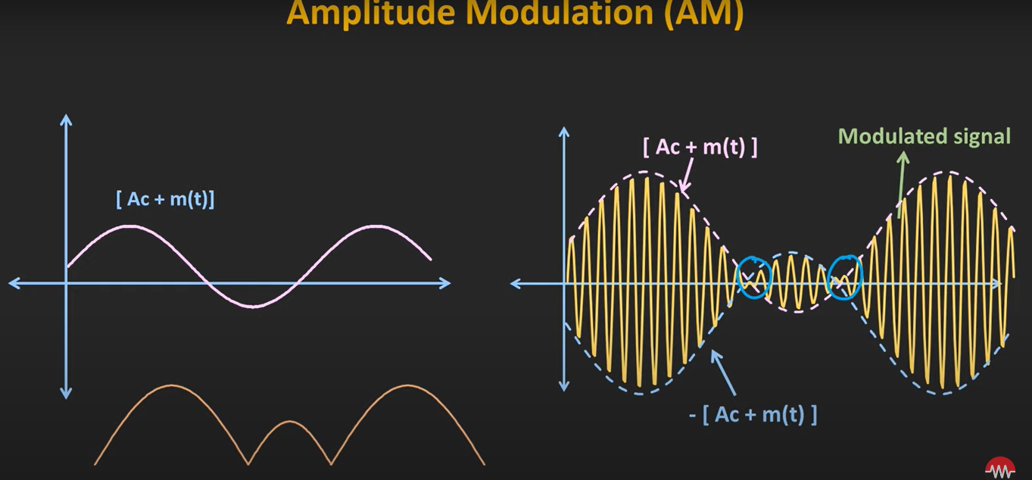
Baseband signal + offset < 0
Modulated signal contains within this envelope. This envelope isn't part of the modulated signal. But at the receiver, if we can generate this envelope from this modulated signal, then its possible to recover the message signal from this envelope.
If you see the shape of this envelope, then it follows the message signal. This technique is known as the Envelope Detection.
Ac + m(t) < 0. if we try to recover the message signal using the envelope detection, then we would get this kind of signal and certainly this is not the message signal.

Slide 10
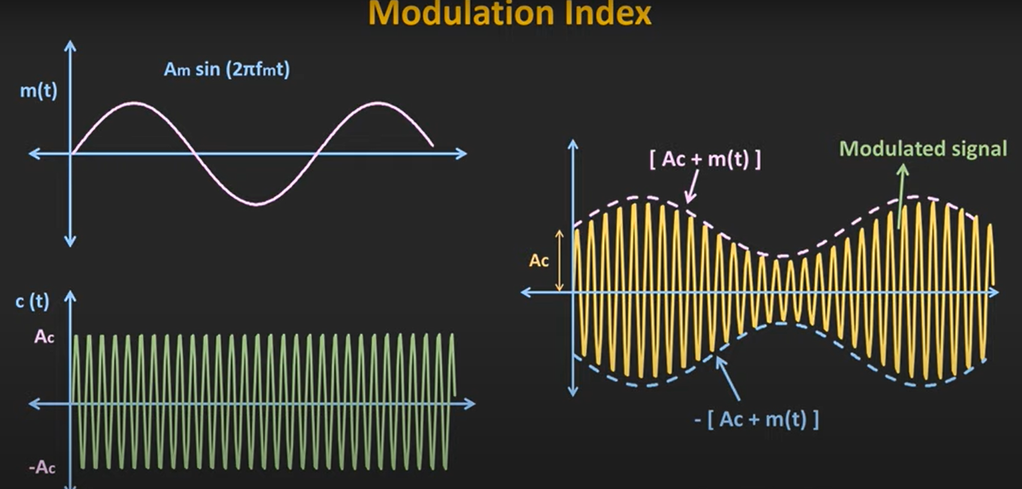
in order to have proper amplitude modulation, modulating signal voltage Vm should be less than carrier voltage Vc. Hence the relationship between amplitudes of these two signals is very important. This relationship is expressed in terms of modulation index(modulation depth).
It defines to what extent the carrier signal gets modulated by this msg signal.
Modulation index = Am / Ac = maximum amplitude of the message signal to the carrier signal.
Recover the message signal using this envelope detection and to avoid the signal distortion and zero crossing, this modulation index should be <= 1.

Slide 11
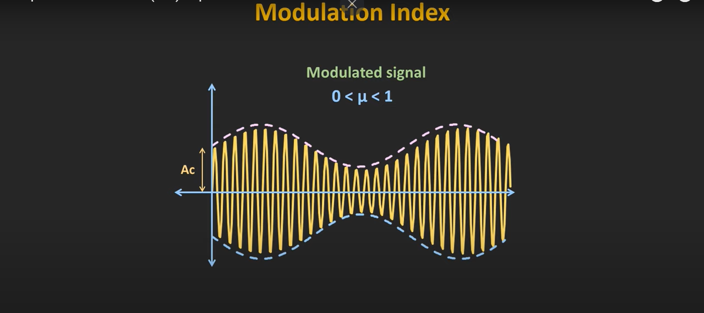
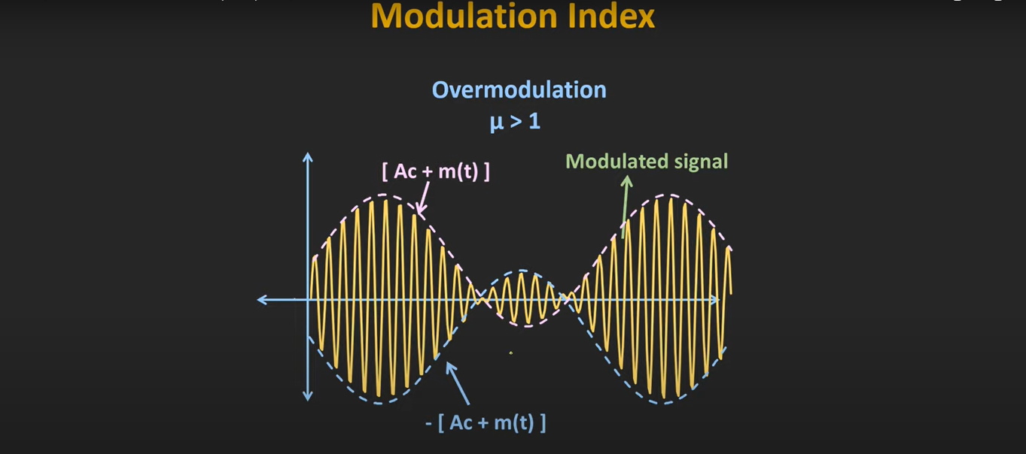
The modulation index should be a number between 0 and 1.
When modulation index is greater than 1, severe distortion results into the modulated waveform. Distortion can introduce errors in recovering the original message.

Slide 12
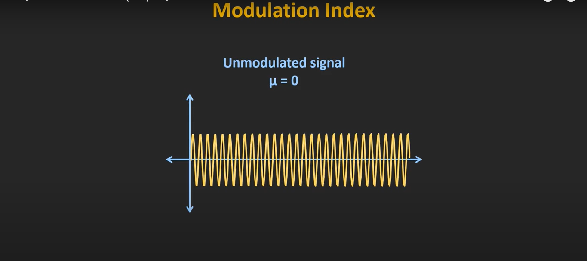
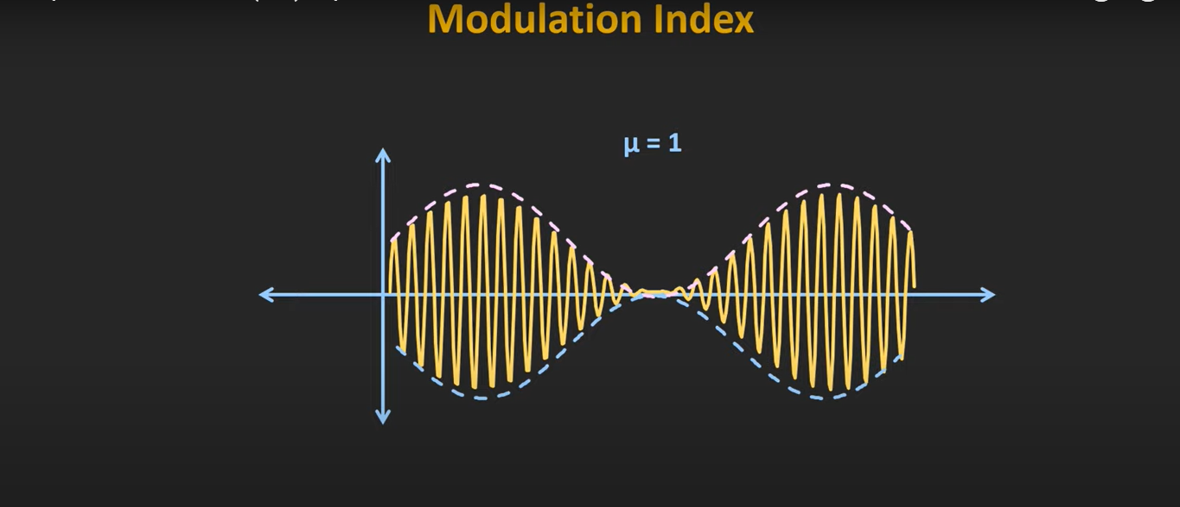
The ideal condition is when Vm is equal to Vc and modulation index is equal to 1. In this situation, greater output is generated at the receiver with no or minimal distortion.
İf modulation index is 0, there is no modulation.

Slide 13
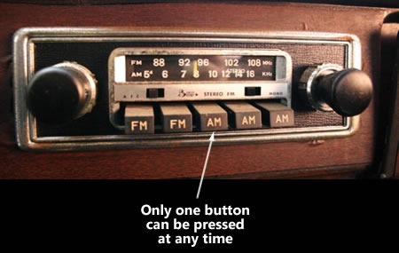
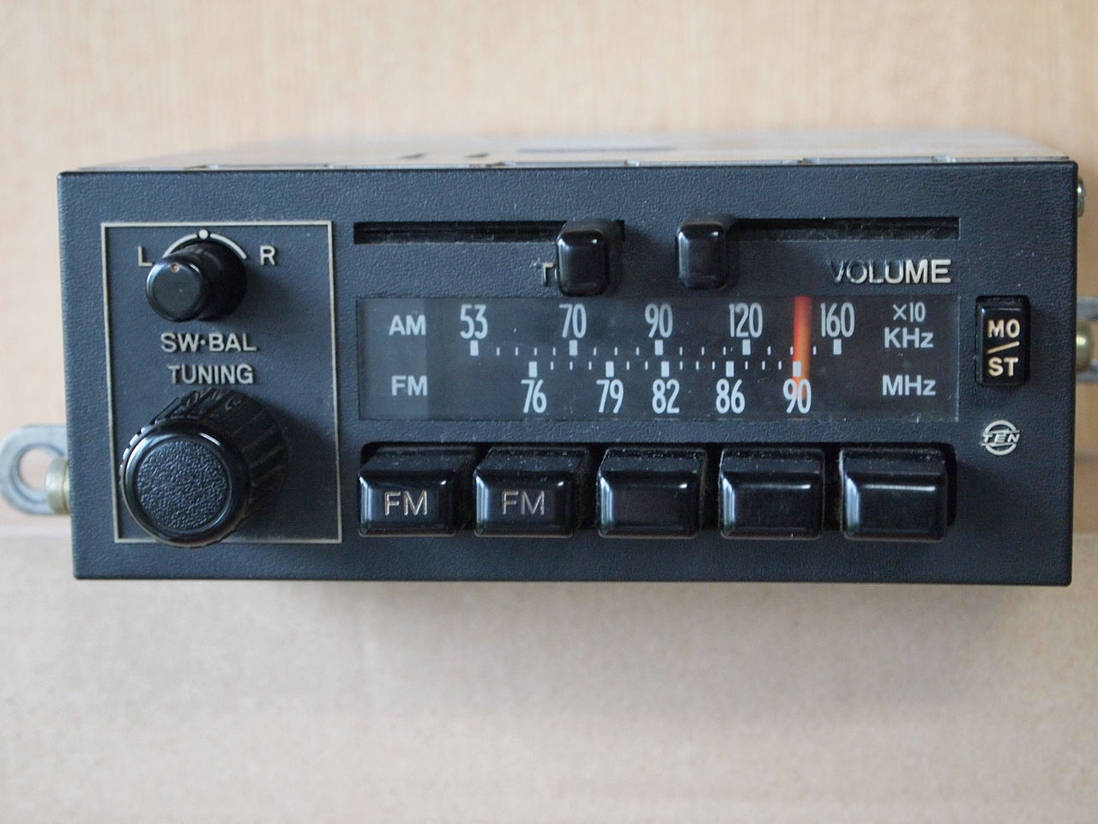
ADVANTAGES OF AMPLITUDE MODULATION
1 – The cost of is low.
2 – They travel long distance and cover a wider area.
3 – It requires simple transmitter and receiver.
DISADVANTAGES OF AMPLITUDE MODULATION
1 – Poor performance due to noise.
2 – Less efficient in terms of bandwidth usage.
3 – Less efficient in terms of power usage.
APPLICATION AREAS
1 – AM is used for radio transmission.
2 – AM is Applied in two-way communication for air traffic control.

Slide 14
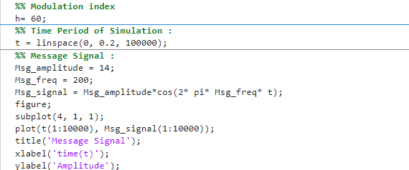
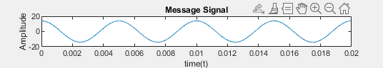
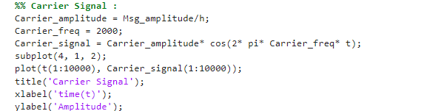
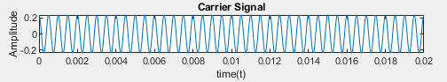
Question 1
First of all let’s create message signal
Then let’s create carrier signal

Slide 15
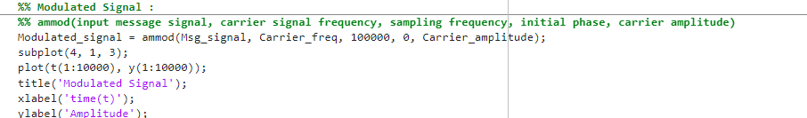
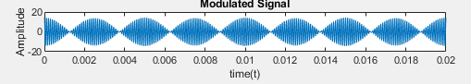
Let’s create Amplitude Modulation signal with using ammod function

Slide 16
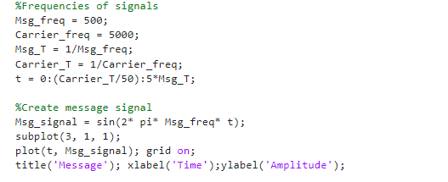
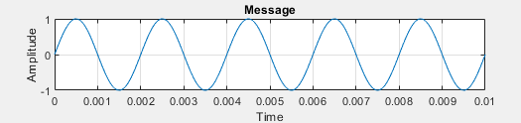
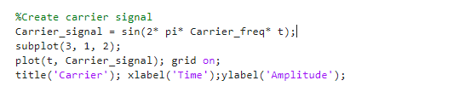
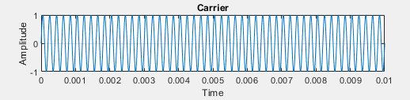
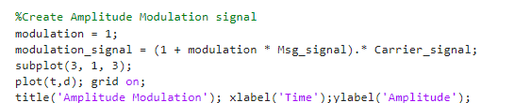
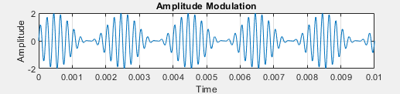
Question 2
Define the reqirements
Creation of the message signal
Creation of the carrier signal

Slide 17
WHAT IS Amplıtude-modulatıon DEMODULATION?
- AM demodulation is the process of obtaining the modulation signal by separating the carrier signal from the amplitude modulation signal.
- This process happens in two stages: rectification and filtering.
As a result, the original modulation signal is recovered, thus obtaining the transmitted information.

Slide 18
Let's take another look at the am signal
An AM signal is usually expressed in the form:
𝑠(𝑡)=𝐴𝑐[1+𝑚⋅𝑚(𝑡)]⋅cos(2𝜋𝑓𝑐𝑡)
Ac​: Carrier signal amplitude
m(t): Modulation signal!!!
fc​: Carrier signal frequency
THE VALUE WE SHOULD OBTAIN AT THE END OF DEMODULATION IS THE MODULATION SIGNAL.

Slide 19
Demodulatıon stages
Rectification (Doğrultma):
The first step in AM demodulation is to rectify the AM signal. This process cuts out the negative parts and passes the positive parts of the amplitude of the carrier signal, which creates the AM signal. The rectification process is usually performed using a rectifier circuit (diode).

Slide 20
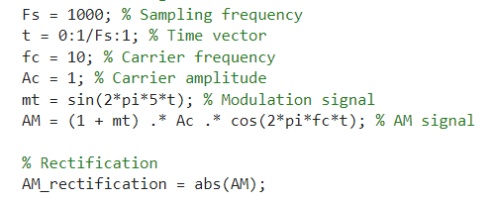
GRAPH OF RECTIFICATION
First, we generate the AM signal.
Then, we delete my signal from negative values ​​thanks to the «abs» function in MATLAB.
And finally, we can compare the graphs with the subplot command.

Slide 21
Demodulatıon stages
Filtering:
The resulting signal after rectification is usually passed through a low-pass filter. This filter removes the fluctuations on the high-frequency carrier signal, resulting in the modulation signal.
A low-pass filter passes the low-frequency components of the signal while suppressing the high-frequency components. In this way, the modulation signal is obtained more clearly.
The combination of these steps enables the separation of the carrier signal and the modulation signal in the AM demodulation process. As a result, the original modulation signal is recovered and the transmitted information is obtained.
We will use the butter low-pass filtering technique in the filtering process.
*Since Butter Low-Pass Filtering will be explained in the 16th group, we will only show it graphically *

Slide 22
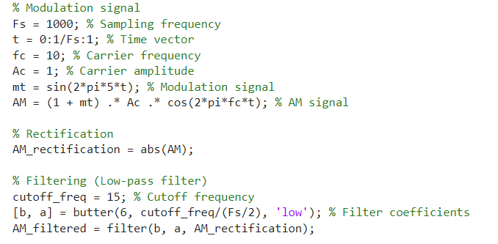
GRAPH OF FILTERING
As in the other example, rectification is first performed via MATLAB.
Then the cutoff frequency is selected for the filtering stage.
Then, the low-pass filtering part is performed with the butter() function.
Finally, the function can be examined from three different perspectives with the subplot function.
After the filtering stage, we obtain the desired "m(t): Modulation signal" with the remaining signal.

Slide 23


